Slide 1
SOK EAI DevOps approach
"Now, here, you see, it takes all the running you can do, to keep in the same place. If you want to get somewhere else, you must run at least twice as fast as that!”
- Lewis Carroll
Jan 19 2015

Slide 2
Current situation and short analysis
EAI platform is built with IBM technologies and is technologically fairly robust solution
Some manual actions are still required to handle exceptions in the system
Platform is extensively used by almost all SOK applications
Service support for the current environment is mainly during store opening hours
SOK has invested on new private cloud platforms from multiple vendors
Technological challenges in the future revolve around two aspects:
The future of AIX platform, following signs suggest a speedy decline
Latest OS version is from 2010
IBM saw its Power Systems sales fall by nearly a third in 2013 ⁽¹⁾
IBM paid $1.5 billion to get rid of Power processor manufacturing ⁽²⁾
Several replatforming programs going on also in the Nordics
Should AIX no longer be a viable solution, then current IBM technologies are not cloud friendly (mainly due to the licensing)
Looking at the following 5 years it is apparent that
Huge changes will be made in the application landscape – these changes also require changes in EAI
AIX platform will cause problems
Cost pressure will increase
The need for agility and speed (time-to-market) will increase
http://recode.net/2014/04/23/ibm-goes-open-source-to-give-old-school-server-chips-new-life/
http://www.bloomberg.com/news/2014-10-19/ibm-agrees-to-pay-globalfoundries-1-5-billion-to-take-chip-unit.html

Slide 3
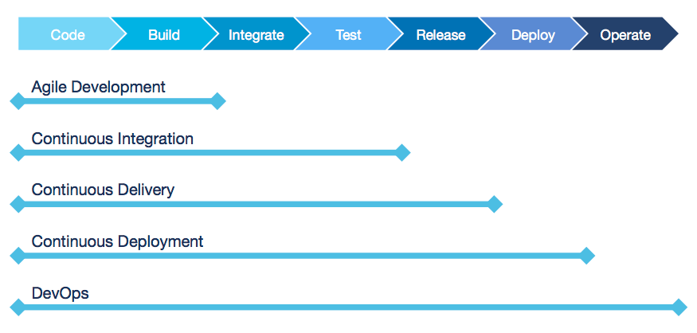
Future state and way forward
In our view SOK needs a solution that
Enables the technical transformation required in the long run to keep EAI platform up to date
Makes it possible to respond to the changes in the applications using EAI
Takes the benefit from the private cloud environments SOK is investing in
The following slides present Capgemini’s view on the requirements/solutions for the new EAI service.
The basic concept can be classified as a DevOps. The main components are pictured below:

Slide 4
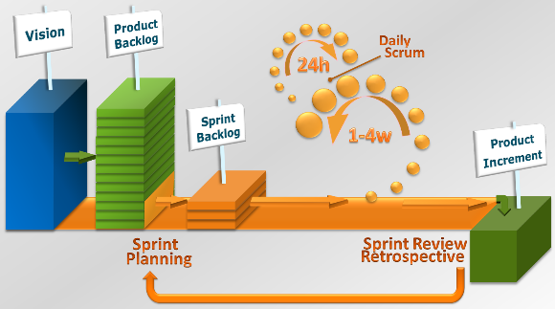
Agile development
What
Why
Recommendation
Agile software development is a group of software development methods in which requirements and solutions evolve through collaboration between self-organizing, cross-functional teams. It promotes adaptive planning, evolutionary development, early delivery, continuous improvement, and encourages rapid and flexible response to change.
Early realization of benefits via incremental delivery
Fast time-to-market with early and regular releases and perpetual beta
Quality with integrated testing
Visibility with mandatory user involvement
Smaller risk associated with smaller releases
Flexibility with using fixed timescale instead of fixed requirements
Cost control with fixed timelines ie. scope and features are variable not cost
Business engagement with product owners and high visibility on the product features
Right end result with ability to change features rapidly
Adapt agile development method
Establish a team of experienced programmers, technical leads and product owners preferably with experience in agile development methods

Slide 5
Continuous Integration
What
Why
Recommendation
Continuous Integration (CI) is a development practice that requires developers to integrate code into a shared repository several times a day. Each check-in is then verified by an automated build, allowing teams to detect problems early.
Improve code quality by minimizing the time between merging code snippets done by individual developers
Monitor code quality by testing (compiling) it daily
Enforce code quality by not allowing commits for code that does not compile
Implement Continuous Integration
Maintain a single source repository
Automate the build
Make build self-testing
Every commit should build on an integration machine
Keep the build fast
Make it easy for anyone to get the latest executable
Implement (and automate) code quality controls
Code review
Static code analysis

Slide 6
Continuous Deployment/Delivery
What
Why
Recommendation
Continuous Delivery (CD) is a design practice used in software development to automate and improve the process of software delivery. Techniques such as automated testing, continuous integration and continuous deployment allow software to be developed to a high standard and easily packaged and deployed to test environments, resulting in the ability to rapidly, reliably and repeatedly push out enhancements and bug fixes to customers at low risk and with minimal manual overhead.
Note: Continuous Delivery doesn't mean every change is deployed to production ASAP. It means every change is proven to be deployable at any time.
Build the right functionalities with continuous feedback from the users
Benefits are gained earlier (albeit in smaller pieces)
Ability to react to changes quickly
Innovation with regular user feedback
Reduce risk associated with infrequent releases by implementing continuous deployment pipeline
Reduce costs by eliminating the manual actions required for deployments
Implement Continous Delivery
Establish an automated deployment pipeline
Establish a feedback loop between the users and developers
Implement automated tasks (ie. testing) required for deployments
Implement Continous Deployment
Extend the deployment pipeline to production environments
Make automated feedback on the production readiness of systems available (especially after deployments)

Slide 7
Test Automation and Service Virtualization
What
Why
Recommendation
In software testing, test automation is the use of special software (separate from the software being tested) to control the execution of tests and the comparison of actual outcomes with predicted outcomes.
Service Virtualization captures and simulates the behavior, data and performance characteristics of complete composite application environments, making them available for development and test teams throughout the software lifecycle, for faster time-to-market with quality software functionality at lower infrastructure cost.
Enable early detection of functional errors and give immediate feedback to developers thus increasing code quality
Improve time to market with virtual test environments (by reducing the requirements for non-scope environments to be available for test runs)
Implement Test Automation
Choose a tool that supports Service Virtualization
Make sure that the chosen tool is integrated to deployment pipeline toolset

Slide 8
Application Performance Management
What
Why
Recommendation
Application Performance Management (APM) consists of tools and processes responsible for monitoring and managing the performance and availability of software applications. APM tools alert IT staff to disruptions in availability and/or quality. In addition to real-time monitoring, many application performance management tools can also prevent problems from occurring by detecting early warning signs of issues and can also help automatically resolve some performance and quality issues.
Enable feedback loop for the team including developers
Facilitate the root cause analysis action with increased visibility on the application state and performance
Help Service Desk to better inform users by linking APM to notification process
Prevent problems by automatically collection the normal metrics for normal application performance and comparing those to the current state in real time
Implement Application Performance Management
Make sure that the chosen tool is integrated to other tools and processes

Slide 9
Technical transformation
What
Why
Recommendation
Realize investments made to make new type of cloud environments available
AIX is a burning platform
Current IBM technology is cloud unfriendly
SATO will require rapid changes to be deployed in the coming years
Faster development and deployment cycles with automated deployment pipeline need to be supported
Automated testing and service virtualization (ie. be able to create and delete test environments dynamically)
Additional cost savings can be achieved by enabling the support of scaling up/down as required (and bring cost benefits when scaling down)
Platform needs to be made future-proof
(Private cloud) migration to x86 platform
Migration of technical components that can utilize cloud benefits (eg. elasticity)
Investigate open source alternatives
Redirect development effort so that new functionalities are built on the new platform and linked to legacy while gradually decommissioning

Slide 10

One-team approach and service model for transformation
Build a team that is responsible for both maintaining and transforming the application
Do the transformation with agile methods within the service ie. accept and welcome change
Be prepared to change the team focus and capabilities as needed – focus on goals
FTEs
Service Management
Legacy maintenance
Cloud application maintenance
Cloud application development
Service Desk
Time

Slide 11
Disclaimer and Disclosure of Information
DISCLAIMER
DISCLOSURE OF INFORMATION
The information contained within this Approach Paper is and shall remain the property of Capgemini Finland Oy. This is an approach paper only and supplied in strict confidence and must not be produced in whole or in part, used in tendering or for manufacturing purposes or given or communicated to any third party without the prior consent of Capgemini Finland Oy.
Any information in this Approach Paper is not, and shall not be construed as, a formal offer for acceptance.
Assumptions and the scope for the services will be jointly verified during the LOI and contract negotiation phase. Capgemini is happy to work with SOK to get to a final contract that replaces this Approach Paper.
This Approach Paper is supplied in strict confidence and the information contained in this Approach Paper includes information the disclosure of which would be likely to cause significant harm to Capgemini’s commercial interests. Therefore, information contained in this Approach Paper must not be disclosed (in whole or in part) in response to any request for information without Capgemini’s prior written consent.
© Capgemini 2015

Slide 12
Additional information related to this presentation will be provided by:
Mika Koykka
Delivery Manager
Phone: +358 40 545 0668
mika.koykka@capgemini.com
Capgemini Finland Oy
Niittymäentie 9
02200 ESPOO

